Slide 1

EcoLoop: Rewarding Your Waste for a Cleaner Planet
EcoLoop is revolutionizing recycling by rewarding your commitment to a cleaner planet. Our innovative approach combines convenient waste collection with a user-friendly mobile app, creating a seamless and incentivized recycling experience.

Slide 2
The Problem: A World of Untapped Potential
Waste segregation remains a significant challenge. Limited motivation and lack of transparency hinder recycling efforts. Existing systems often fail to engage individuals or provide tangible rewards.
Lack of Transparency
Limited Motivation
Users don't know where their recyclables end up.
Recycling can feel like a chore without incentives.

Slide 3
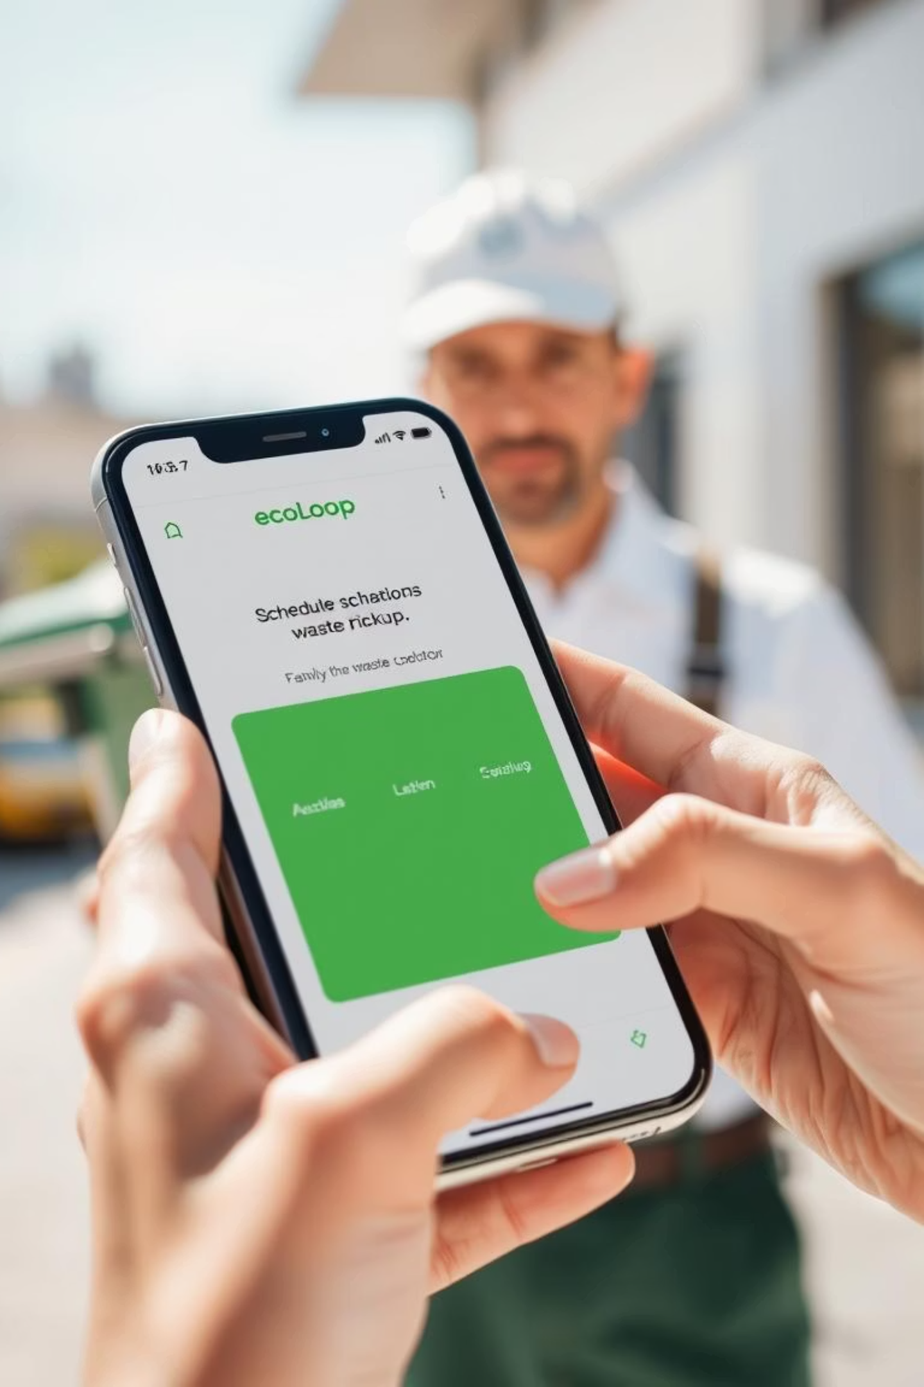



EcoLoop: Recycling Reimagined
EcoLoop offers door-to-door waste collection services. Our mobile app tracks waste types and rewards users with points. We promote conscious recycling and environmental responsibility.
Door-to-Door Collection
Convenient waste pickup from your doorstep.
Mobile App Tracking
Track waste types and earn rewards.
Conscious Recycling
Promoting environmental responsibility.

Slide 4





How EcoLoop Works: A Step-by-Step Guide
Schedule Pickup
Users schedule pickups via the app.
Weigh and Categorize
Waste is weighed and categorized accurately.
Update Stats
App updates waste stats and awards points.
Redeem Points
Points redeemed in the unknown link.

Slide 5

The EcoLoop Advantage: Tech Meets Sustainability
Real-Time Waste Tracking
Monitor your environmental impact.
Reward-Based Recycling
Incentives for eco-conscious behavior.
Gamification
Fun and engaging recycling experience.
User Impact Stats
Quantifiable results for a greener planet.

Slide 6
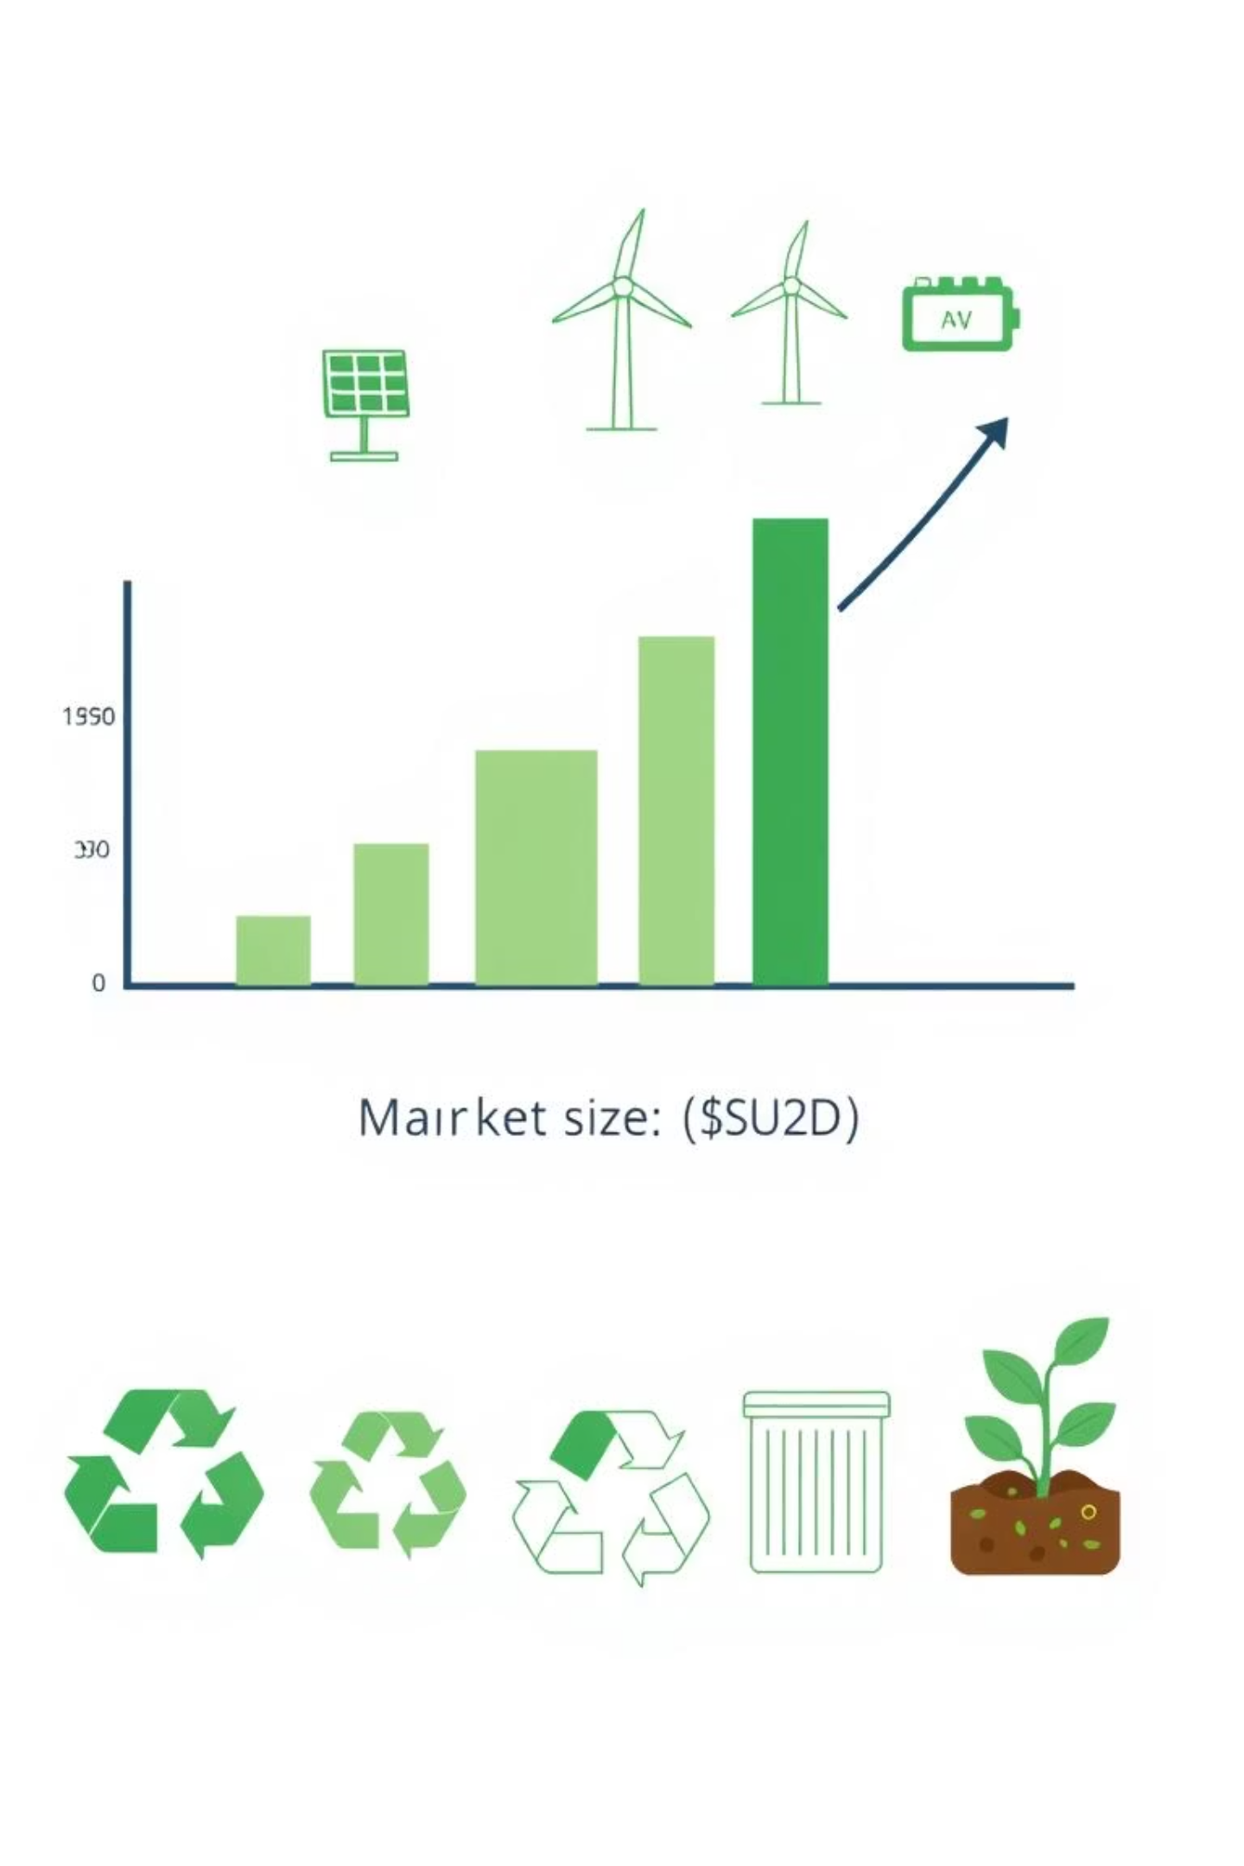
A Growing Market: Sustainability is the Future
The recycling and sustainability market is expanding. Consumers are increasingly interested in eco-conscious living. Circular economy solutions are gaining traction.
8%
Projected annual growth of the recycling market.
65%
Consumers prefer sustainable brands.

Slide 7
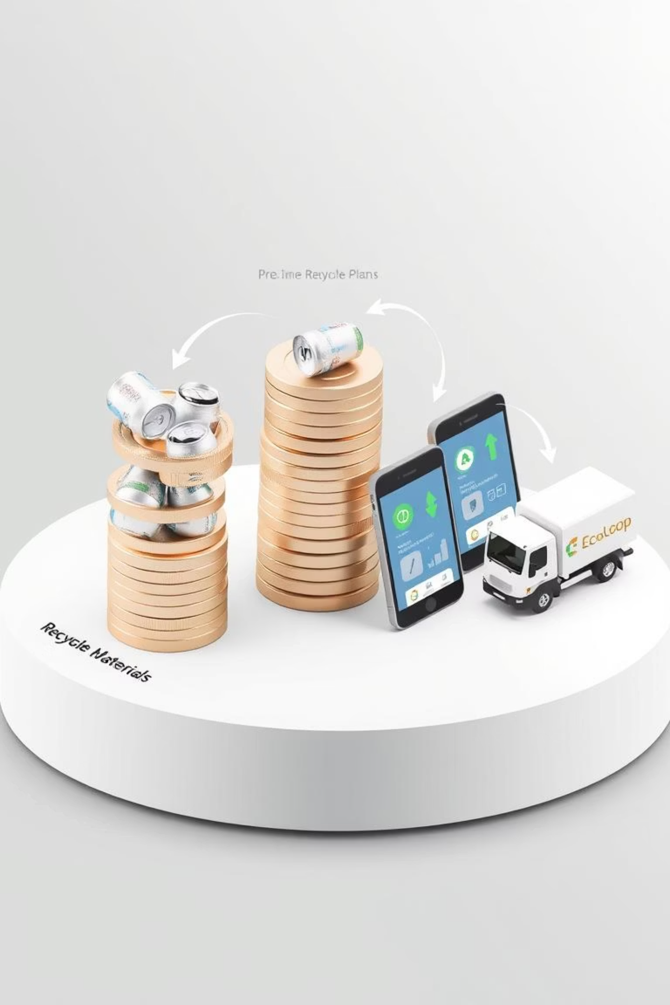
EcoLoop's Revenue Streams: A Sustainable Model
Recyclable Materials
Revenue from selling sorted materials.
In-App Commissions
Commissions on product sales.
Premium Plans
Premium pickup plans for added convenience.

Slide 8




Benefits for EcoLoop Users
Rewards and Discounts
Eco-Conscious Habits
Leaderboards
Users earn rewards and discounts. EcoLoop encourages sustainable habits. They join local leaderboards and support green products.

Slide 9
EcoLoop vs. Traditional Recycling
Traditional Recycling
EcoLoop
Limited tracking
App integration
No rewards
Transparency
Lack of engagement
Gamification
Community incentives

Slide 10
Join the EcoLoop Revolution
Seeking $150K seed funding to build the app, expand logistics, and onboard the first 10,000 users. We are open to green partnerships and tech collaborations.
Seed Funding: $150K
App Development
Logistics Expansion
User Acquisition

